Slide 1
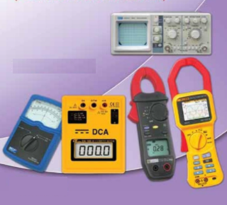
ELECTRONIC MEASUREMENTS
AND INSTRUMENTATION
Instructor: Mr. B.ManiKanth, Assistant Professor
Department of Electronics and Communication Engineering

Slide 2
UNIT-2
Signal Generator- fixed and variable, AF oscillators, Standard and AF sine and square wave signal generators, Function Generators, Square pulse, Random noise, sweep, Arbitrary waveform. Wave Analyzers, Harmonic Distortion Analyzers, Spectrum Analyzers, Digital Fourier Analyzers.

Slide 3
Electronic measurement and Instrumentation
UNIT-II
Signal Generators & Wave Analyzers

Slide 4
Signal Generators
A Signal Generator is a vital component in a test setup, and in electronic troubleshooting and development(Service bench or Research lab)
They provide variety of waveforms for testing electronic circuits , usually at low powers
Applications:
Checking stage gain
Frequency response
Alignment in receivers etc.

Slide 5
There are various types of signal generators but several requirements are common to all types
The frequency of the signal should be known and stable.
The amplitude should be controllable from very small to very large values.
The signal should be distortion free.

Slide 6
Frequency Band limits
Band | Approximate Range
AF | 20Hz-20KHz
RF | Above 30KHz
VLF | 15-100KHz
LF | 100-500KHz
Broadcast | 0.5-1.5MHz
Video | DC - 5MHz
HF | 1.5-30MHz
VHF | 30-300MHz
UHF | 300-3000MHz
Microwave | Beyond 3GHz

Slide 7
Oscillators
There are two types
Fixed Frequency AF Oscillator
Variable AF Oscillator

Slide 8
Fixed Frequency AF Oscillator
Fixed frequency might be a 400Hz Signal used for audio testing or a 1000Hz signal for exciting a bridge circuit
Oscillators at specified AF are easily generated by the use of an iron core transformer to obtain positive feedback through inductive coupling b/w primary and secondary windings.

Slide 9
Variable AF Oscillator
A variable AF oscillator for general purpose use in laboratory should cover at least the full range of audibility 20 Hz to 20KHz
And should have a fairly constant pure sinusoidal wave output over entire frequency range
Hence this type for laboratory uses RC feedback oscillator type or BFO

Slide 10
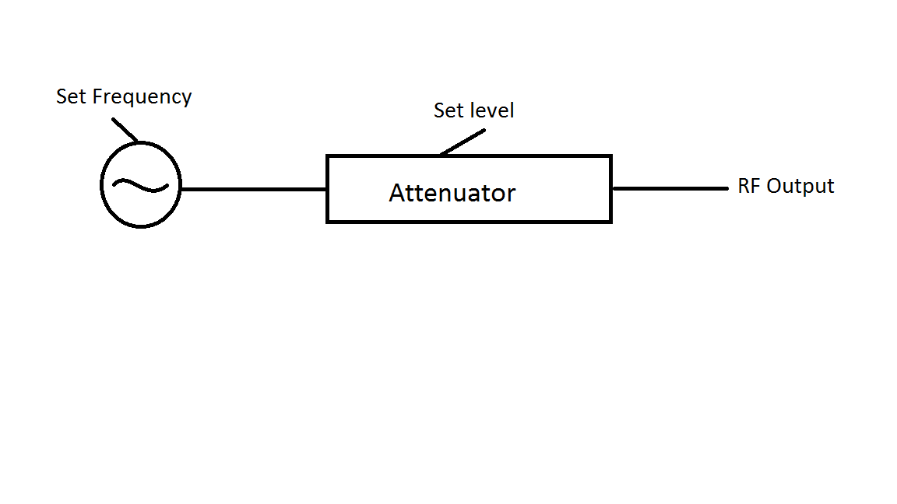
Basic Standard Signal Generator
Fig: Basic Sine wave Generator

Slide 11
Basic Standard Signal Generator(cntd.)
Covers frequency from few Hz to many GHz
Accuracy of frequency, stability and freedom from distortion depends on design of oscillator
Amplitude depends on design of the attenuator

Slide 12
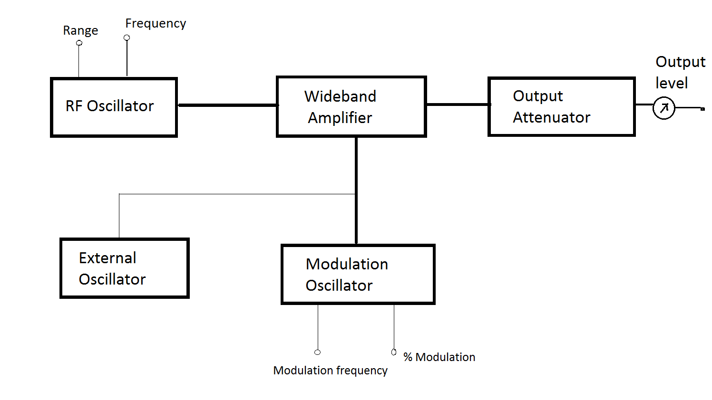
Standard Signal Generator
Fig: Conventional Standard Signal Generator

Slide 13
Working:
Provides known and controllable voltages
Carrier signal is generated by stable RF oscillator by using an LC tank circuit
Carrier signal can be modulated with sine/square/pulse/triangular waves
AM/FM Output can be obtained at the output of signal generator through modulation circuit
The modulated carrier can be fed through output attenuator and output can be read through meter

Slide 14
Applications:
Can be used as power source for measuring gain, SNR, standing wave ratio
Extensively used for testing radio transmitters and receivers
Advantages:
Output voltage can be controlled as per our requirement
Stable output

Slide 15
Disadvantages:
The frequency stability is limited by LC circuit of RF oscillator
At high frequencies it is essential to isolate oscillator circuit from output circuit

Slide 16
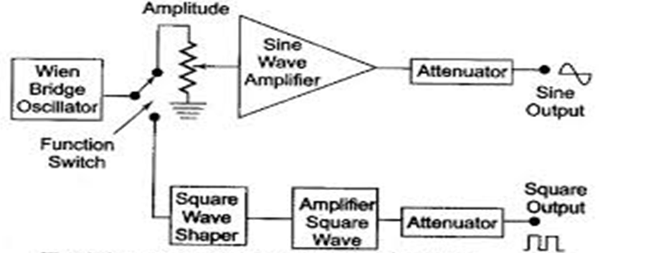
AF Sine & Square wave Generator

Slide 17
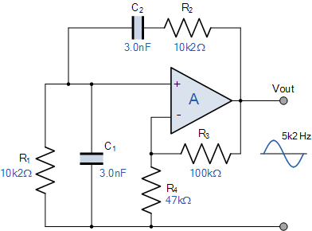

Wien Bridge Oscillator Frequency
Where:
ƒr is the Resonant Frequency in Hertz
R is the Resistance in Ohms
C is the Capacitance in Farads

Slide 18
Working:
Wien bridge(Wheatstone bridge) oscillator is used for best audio frequency range
Switch connects oscillator to either square wave shaper or sine wave amplifier
The frequency of oscillations can be changed by varying the capacitor value or by switching in the resistors of different values
When connected to position-1, it generates pure sinusoidal waveform of amplitude varying from (5mV-5V) rms
When connected to position-2, it generates square wave of amplitudes varying from (0-20)V

Slide 19
Specifications:
Frequency range: 10Hz -1MHz
Sine wave amplitude: 5mV-5V
Square wave amplitude: 0-20V_{P-P}
Duty cycle of square wave: 30-70%
Power required: 7W( at 220V,50Hz)

Slide 20
The front panel of generator consists of:
Frequency selector:
-It selects the frequency in different ranges
Frequency multiplier:
-it selects frequency ranges over 5 decades from 10Hz-1MHz
Amplitude multiplier:
-It attenuates sine wave amplitude in 3 decade i.e. X1, X0.1, X0.01
Variable amplitude:
-It attenuates sine wave amplitude continuously

Slide 21
Symmetry control:
-It varies the symmetry & a square wave from 30-70%
Functional switch:
-It selects either a sine wave or a square wave
Sync:
-It provides synchronization of input signal with external signal
ON/OFF switch

Slide 22
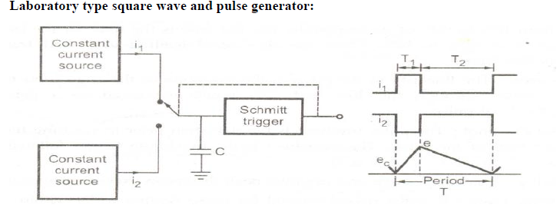
Square and Pulse Generator

Slide 23
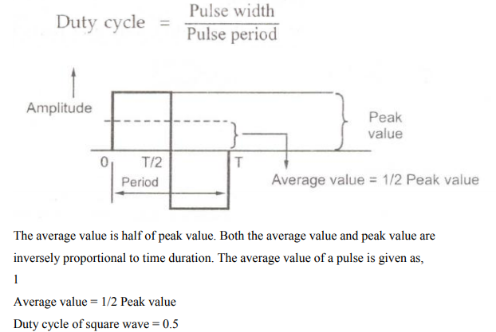
Duty cycle :
The duty cycle is defined as the ratio of average value of a pulse over one cycle to the peak value.
It is also defined as ratio of the pulse width to the period of one cycle.

Slide 24
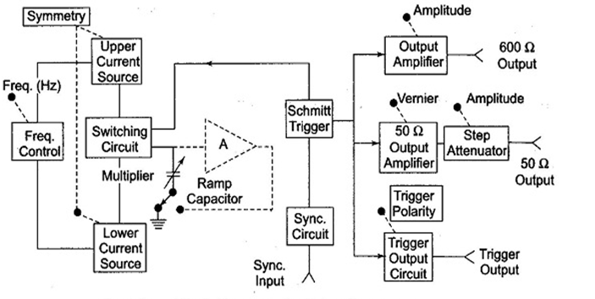
Square and Pulse Generator
Fig: Square and Pulse Generator

Slide 25
Square and pulse generator(cntd):
The fundamental difference between a pulse generator and a square generator is in Duty cycle
A square wave generator has 50% duty cycle
Frequency range: 1Hz-10MHz
Duty cycle :25-75%
Can be operated as free running generator

Slide 27
Requirements of a pulse:
Minimum distortion
Basic characteristics are rise time, overshoot, and undershoot
Should have sufficient maximum amplitude
Output Impedance
DC Coupling of output circuit
The range of frequency control of PRR should meet the needs of the experiment

Slide 28
Working:
It is a asymmetrical multivibrator
Two independent outputs are available,
i) 50 ohms source that supplies pulse with a rise and fall time of 5ns at 5V peak amplitude
ii) 600 ohms source which supplies pulse with rise and fall time of 70ns at 30V peak

Slide 29
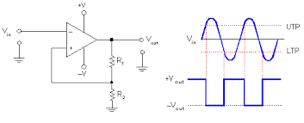

Slide 30
Working:
Upper and lower constant current sources produce current to capacitor
They produce a positive and negative slope ramp voltage signals
Schmitt trigger switches the position from one current source to another when the ramp reaches the predetermined level
The ratio i1/i2 = duty cycle, controlled by symmetry control
i1+i2 determines the frequency.

Slide 31
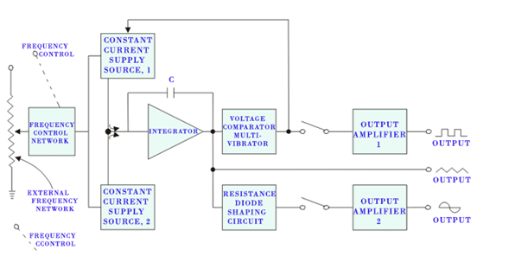
Function generator

Slide 32
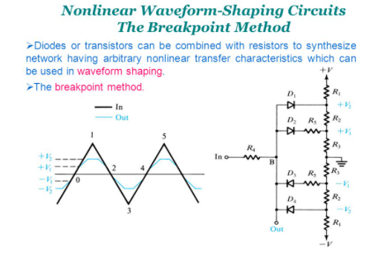
Diode resistance shaping circuit

Slide 33
Working:
Usually frequency is controlled by varying capacitor in LC or RC circuit. But in this circuit freq is controlled by varying the magnitude of current which drives integrator.
The frequency may be adjusted from fraction of Hz to several KHz i.e. 0.01Hz-100KHz
The frequency control voltages regulates the two constant current sources
The upper and lower current sources produces current to the integrator and the output is a positive and negative going ramp signal
When the output of one current source exceeds the predefined level then voltage comparator switches it to the other current source

Slide 34
Hence the output of integrator is a triangular wave, whose frequency depends on magnitude of current
The output of voltage comparator multivibrator is a square wave.
The output of resistance diode network produces a sine wave with less than 1% distortion

Slide 35
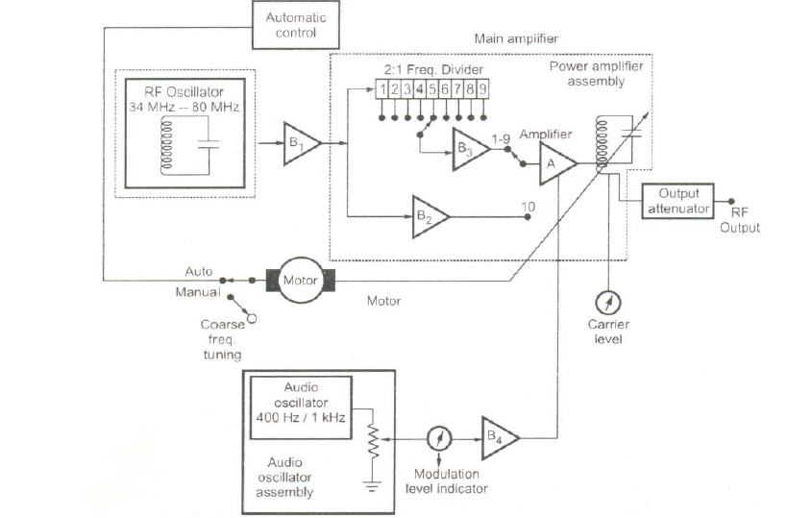
Modern laboratory type signal generator

Slide 36
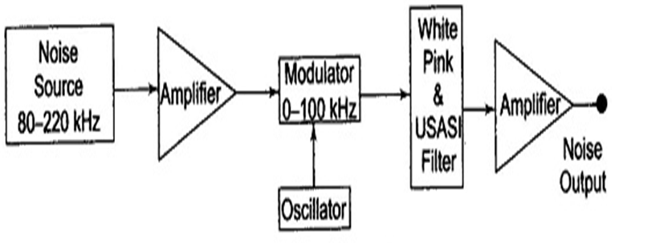
Random Noise Generator

Slide 37
Working:
Generates an output waveform in which the amplitudes are varied randomly
It used at audio frequency range
Frequency range:80Hz-220KHz
Output from noise diode is amplified and applied to balanced modulator
The filter arrangement is used to control the bandwidth where it is mixed down to a band of AF range
It supplies output signals in three spectrum choices i.e. White, Pink & USASI noises

Slide 38
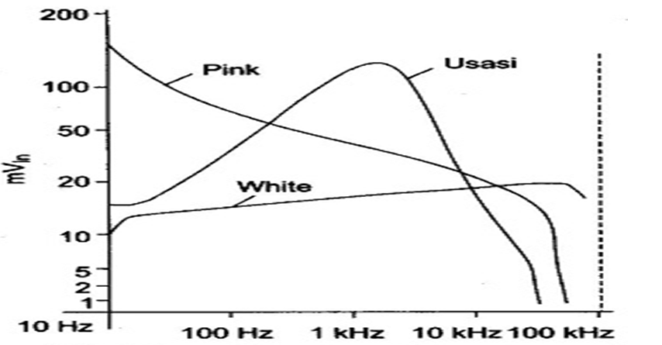
Frequency response of random noise generator

Slide 39
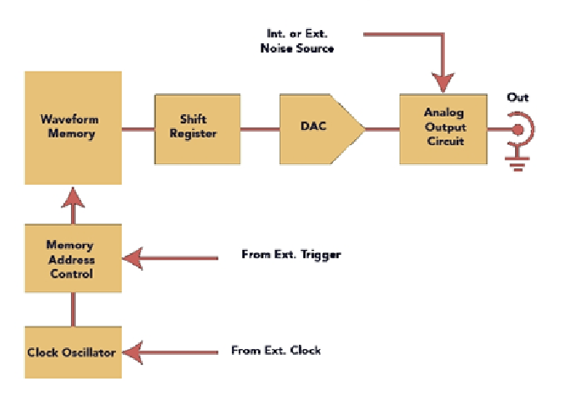
Arbitary waveform generator

Slide 40
Working:
The main objective of AWG is to generate an arbitary waveform with better fidelity
Generates the waveforms based on digital data stored in RAM which gives the detailed information of desired waveform
The DAC produces voltage which is proportional to applied input
The DAC output is a stair case wave form

Slide 41
Advantages :
Produces waveforms which are randomly varied in amplitude and frequency
Waveforms doesn’t contain predefined shape or characteristics
It may be periodic or non periodic
Includes transients and noise components
Used as test signal

Slide 42
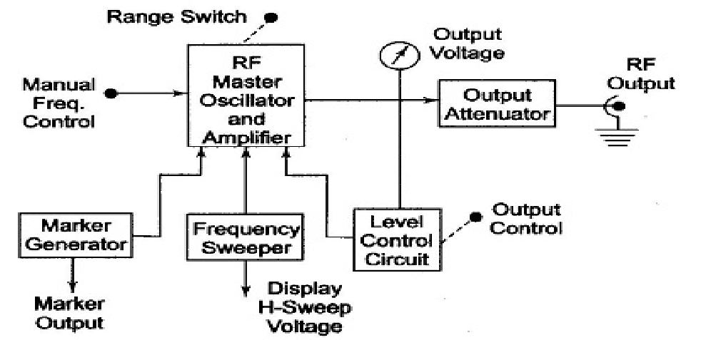
Sweep Generator
Fig: Sweep Generator

Slide 43
Working:
It provides sinusoidal output voltage, usually at audio rate
Frequency modulation is done electronically by modulating voltage w.r.t reactance of oscillator tank circuit
The modulating voltage is generated by frequency sweeper or time base circuit
The RF master oscillator generates carrier and amplifier performs the FM modulation.

Slide 44
The master oscillator resonant frequency is manually controlled.
The modulating voltage causes the capacitance of master oscillator to vary which varies the frequency of the RF oscillator output linearly w.r.t. the modulating voltage.
Automatic level control circuit adjusts the power delivered to the load and provide constant output independent of frequency and impedance changes.

Slide 45
Wave analyzer
Can be used to detect the amplitude of each harmonics or fundamental separately within the frequency range of 10Hz-40MHz
It is basically a frequency selective voltmeter which can be tuned to a frequency of one signal component rejecting all other frequencies
Applications:
To carry out complete harmonic analysis
To measure relative amplitudes of single frequency component in a complex waveform
In electrical measurements

Slide 46
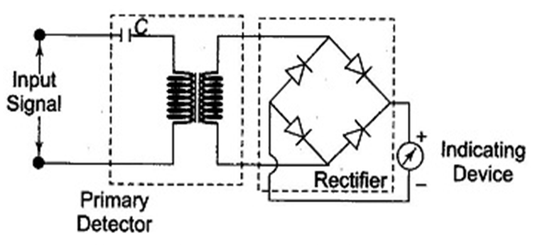
Block diagram :
Fig: Basic wave analyzer

Slide 47
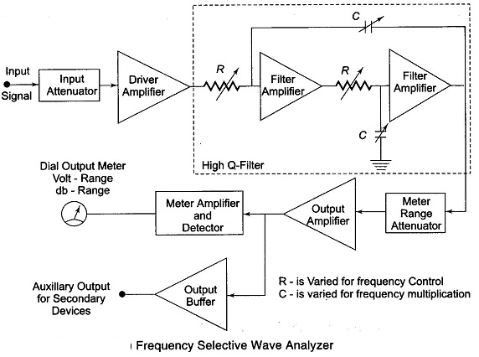
Frequency selective wave analyzer

Slide 48
Working:
Used for measurements in AF range i.e. 20Hz-20KHz
Consists of narrow band pass filter section tuned to a single frequency component
The complex waveform to be analyzed is applied to a adjustable attenuator which serves as range multiplier
The output of attenuator is applied to high Q-filter circuit through a driver amplifier
The Q-filter transmits one signal frequency and rejects all other frequencies
The capacitor is used for selecting frequency range
The precision potentiometer is adjusted for obtaining single frequency component
Finally, the output is amplified and applied to buffer amplifier & meter circuit

Slide 49
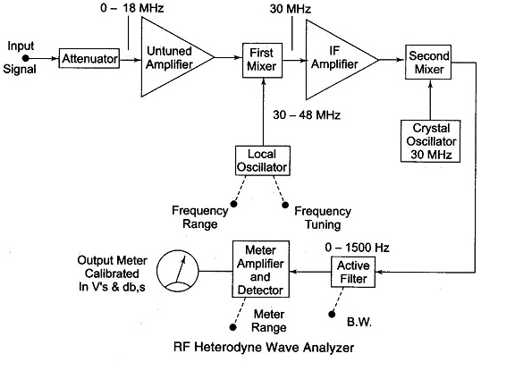
Heterodyne wave analyzer

Slide 50
Working:
Can be used for measurements in RF range and above MHz range
Operates on basic principle of heterodyne or mixing
Input signal to be analyzed is applied to attenuator & untuned amplifier
The output is mixed(heterodyned) with signal of 30-48MHz frequency from LO. The first mixer produces an IF signal of 30 MHz
Now this IF signal is again mixed with signal of 30MHz from LO. This produces IF of zero frequency

Slide 51
Harmonic distortion
When a sinusoidal signal is given as input to any electronic instrument there should be output in sinusoidal form, but generally the output is not exactly the replica of input, because of various types of distortion that may occur due to non-linearity's
These non-linear behaviour introduces harmonics of fundamental frequency in output signal
Total harmonic distortion (THD):

Slide 52
Types of Distortion
Frequency distortion: This type of distortion occurs in amplifiers because of amplification factor of amplifier is different for different frequencies.
Amplitude distortion: It occurs because amplifier introduces harmonic of fundamental of input frequency. Harmonics always generates distortion in amplitude. E.g. when amplifiers are overdriven it clips the waveform.
Phase distortion: This distortion occurs due to energy storage elements in the system which causes the output signal to be displaced in phase with the input signal. Signals with different frequencies will be shifted by different phase angles.
Inter-modulation distortion: This type of distortion occurs as a consequence of interaction or heterodyning of two frequencies, giving an output which is sum or difference of the two original frequencies.
Cross-over distortion: This type of distortion occurs in push-pull amplifiers on account of incorrect bias levels

Slide 53
Harmonic distortion analyzer
Can be used to measure total harmonic distortion without indicating the amplitude and frequency of each component
The signal can be passed through band rejection filter which rejects the fundamental frequency and allows the harmonics for measurements
It uses bridge circuit
-Resonant bridge type
-Wien bridge type
-Bridge T-type

Slide 54
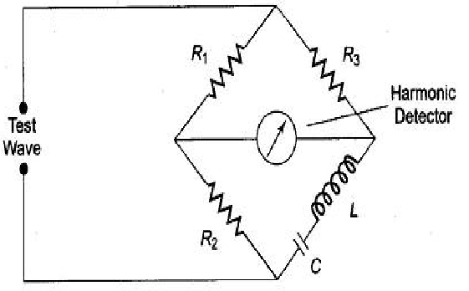
Resonant bridge type:
When the circuit is tuned to a fundamental frequency then the bridge is said to be balanced for fundamental frequency
The bridge is unbalanced for harmonics
Continuous adjustment of frequency is required

Slide 55
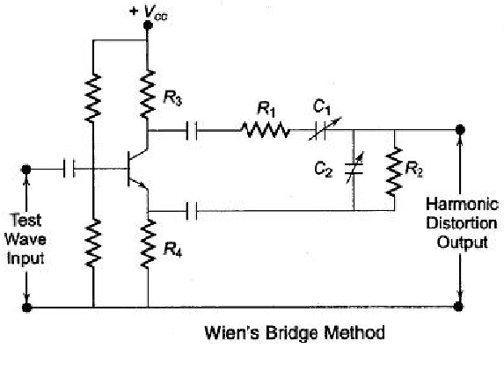
Wien Bridge Type:
It can be used as rejection filter for fundamental frequency of input signal
It offers varying degrees of phase shift and attenuation

Slide 56
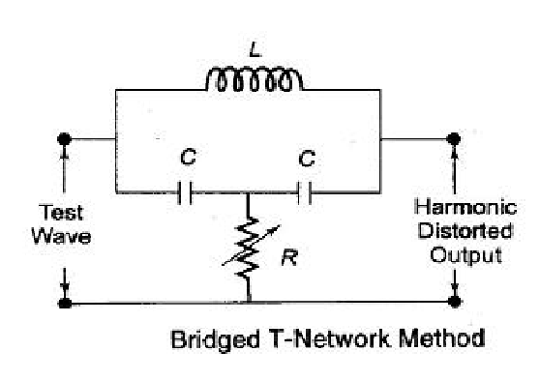
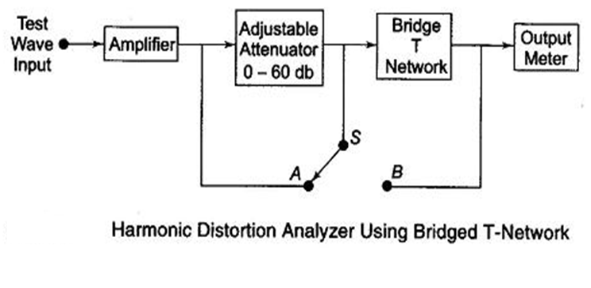
Bridge T-type:

Slide 57
Applications of Harmonic Distortion
It is used to measure the Total Harmonic Distortion
It can be used to analyze the fundamental and its harmonics
It is used in design and development of audio circuits
It is used in analog and digital circuits to measure distortion employed by various components in the circuit

Slide 58
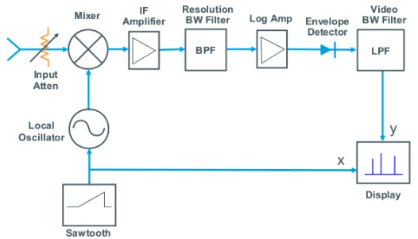
Swept super heterodyne spectrum analyzer

Slide 59
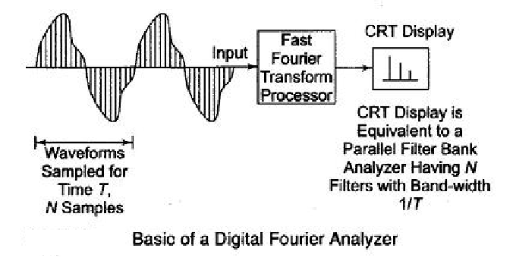
Digital Fourier Analyzer

Slide 60
Working:
The digital Fourier analyzer is based on the calculation of DFT by using an algorithm
This algorithm gives amplitude & phase of each signal component from a set of time domain samples of input waveform
FFT is a very efficient mathematical technique for computation of spectrum of waveform
First analog signal is sampled & then turned to digital form using ADC
The FFT processor performs desired calculations on time record for frequency domain representation
Finally, the result is displayed on CRT

Slide 61
Characteristics of spectrum analyzer
Sensitivity:
The ability to detect small changes is known as sensitivity. It is used in lower level modulation
Dynamic range:
The ability to display and detect small & large signals simultaneously
Frequency resolution:
The ability to separate the signals which are closely spaced in frequency. It depends on Bandwidth & sensitivity of IF amplifier
Harmonic mixing:
The frequency range can be increased by harmonic mixing

Slide 62
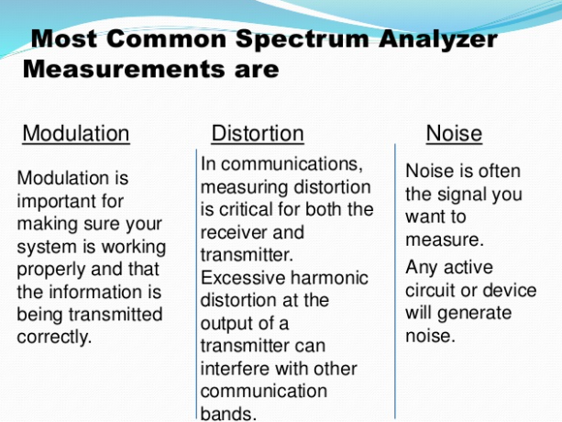
Applications

